Slide 1
ATTENTION SIGNAL
Teacher: I need your attention in 5...4...3...2...1
Students:
Clap Clap
Eyes & knees on me
Voice level 0

Slide 2
Turn & Talk Procedure
With the indicated partner
Turn your body so that your knees and your partner’s knees are facing
Eyes on your partner
Listen for teacher’s cues and take turns talking and sharing

Slide 3
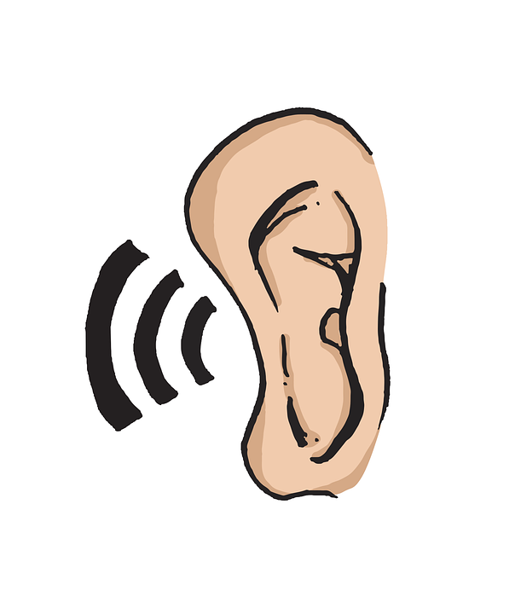
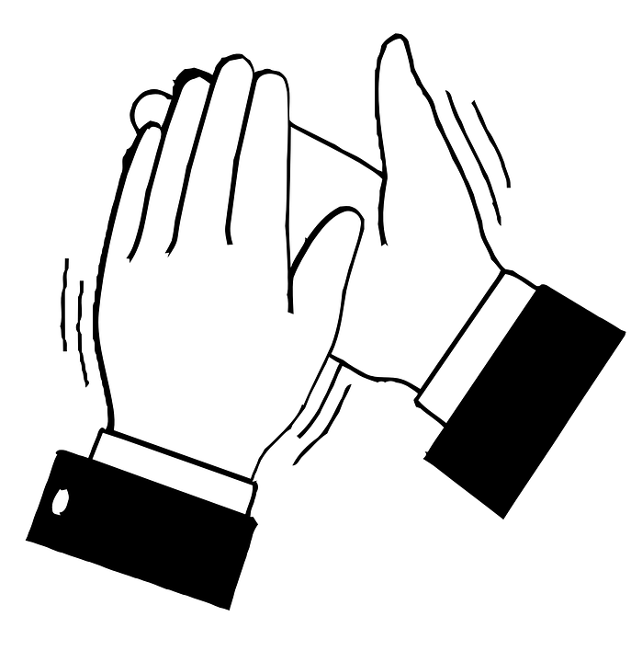
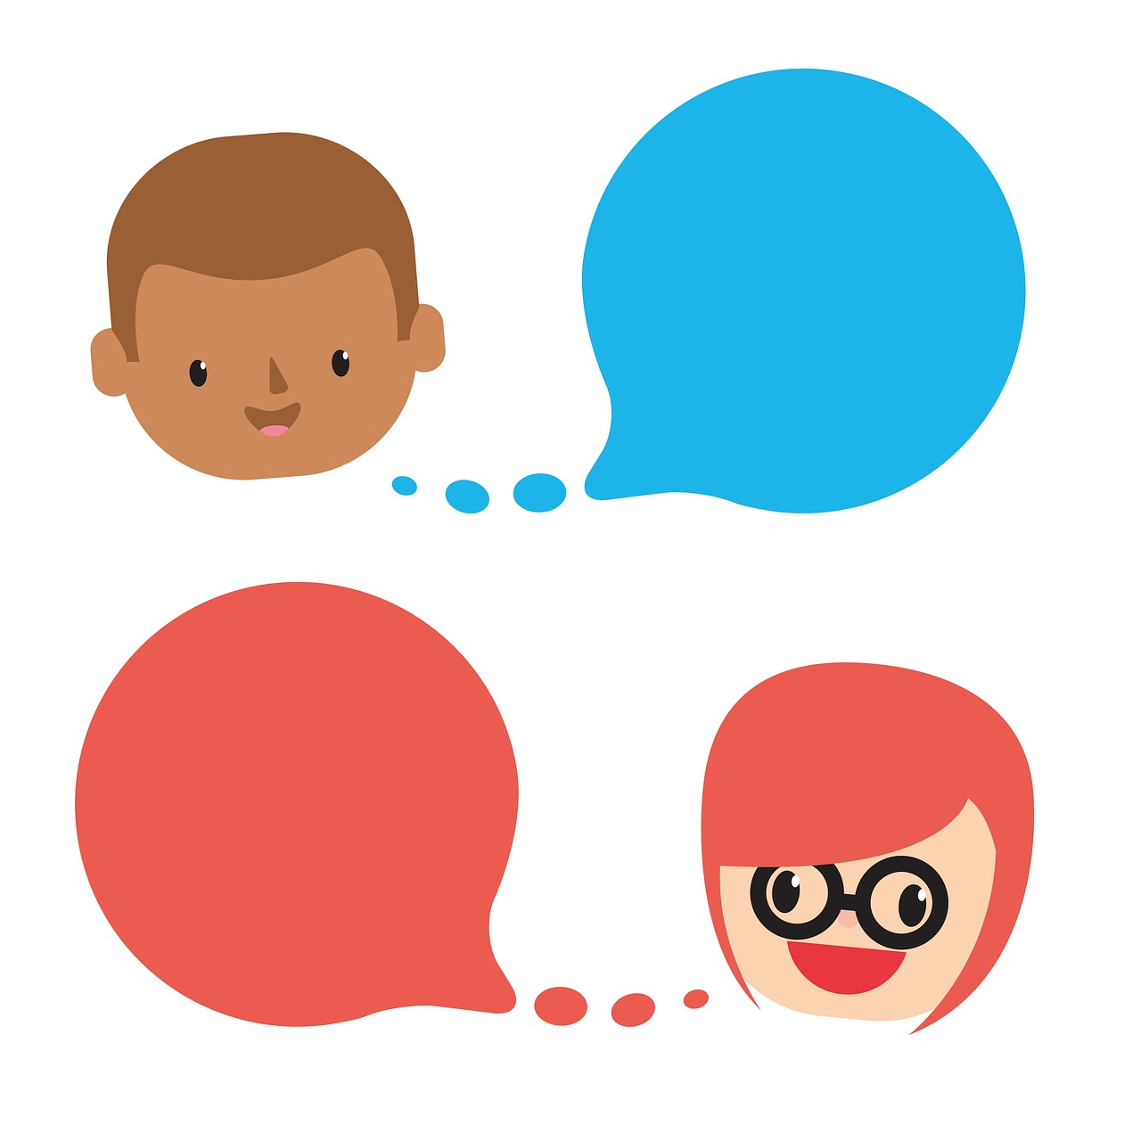
Let’s Practice!
On the next slides, you will see a prompt to discuss with your partner.
Be ready to respond when you hear the attention signal!

Slide 4
Cues to practice attention signal #1
Would you rather have every movie spoiled for you before you watch it or not be able to watch a new movie until it’s been out for a year?
Partner A

Slide 5
Cues to practice attention signal #2
Would you rather have eyes that can capture everything on video or ears that can record all sounds?
Partner B

Slide 6
Cues to practice attention signal #3
Would you rather be the best at something no one cares about or be slightly above average, but nowhere near the best at something people care about?
Partner C

Slide 7
Cues to practice attention signal #4
Would you rather be able to see 10 minutes into your own future or 10 minutes into the future of anyone but yourself? WHY?
Partner D

Slide 8
Cues to practice attention signal #5
Would you rather have an easy job working for someone else or work for yourself but work incredibly hard? WHY?
Partner A

Slide 9
Cues to practice attention signal #6
Would you rather be completely alone for 5 years or constantly be surrounded by people and never be alone for 5 years? WHY?
Partner B

Slide 10
Cues to practice attention signal #7
Would you rather have a horrible job, but be able to retire comfortably in 10 years or have your dream job, but have to work until you are 80 years old? WHY?
Partner C

Slide 11
Cues to practice attention signal #8
Would you rather not be able to taste OR not be able to smell? WHY?
Partner D

